Slide 1
CONCRETE CHANNEL
Analysis of the channel was completed for the approximately 2 mile length.
Channel is generally in fair condition
Localized repairs will be required through O&M to maintain safe operation over the next 50 yrs.
Repair locations have been prioritized
The areas posing the most significant risks have been selected for repairs as part of the TSP (Tentatively Selected Plan)
Wall Repairs
Center Wall Reinforcement
Ceiling Span Removal

Slide 2
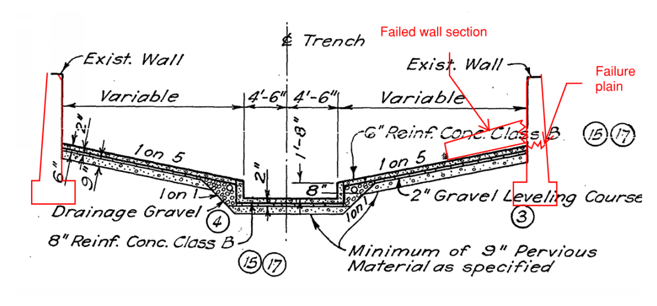
Potential Channel Wall Failure

Slide 3
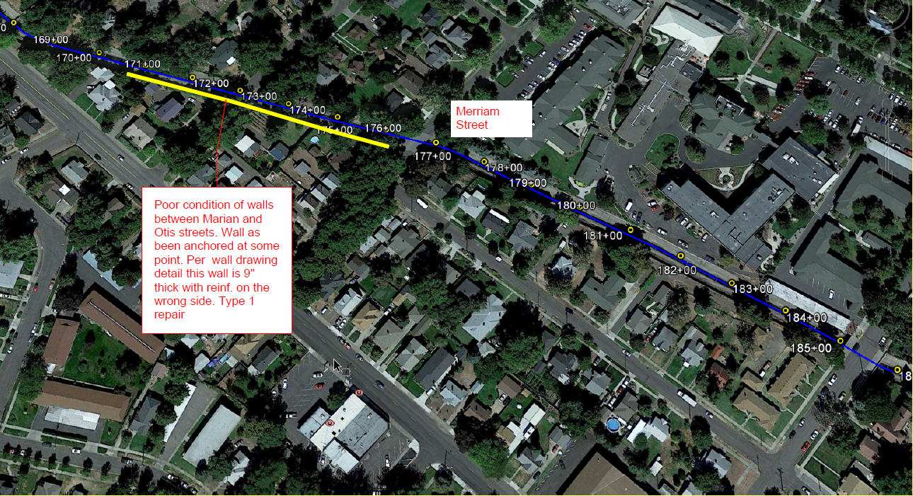
Concrete channel Wall rehab Otis and Merriam

Slide 4
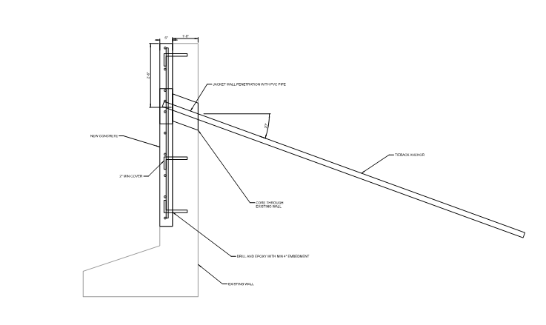
Recommended Repair Wall tie back

Slide 5
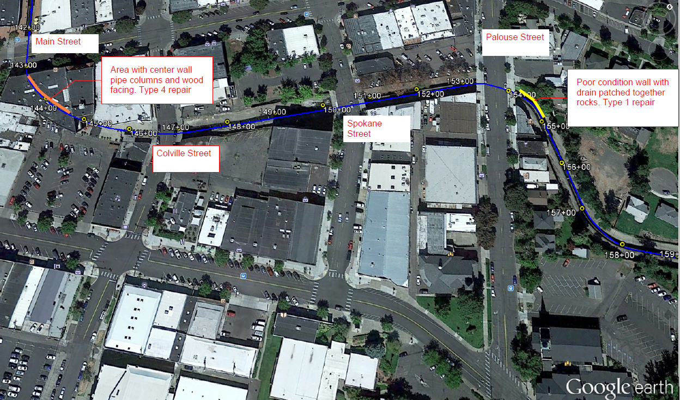
Concrete channel rehab by Palouse street and center column wall repair

Slide 6
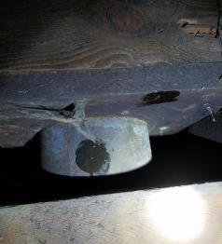
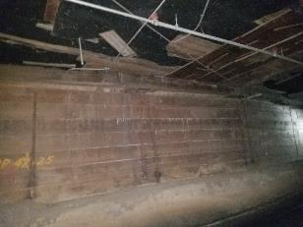
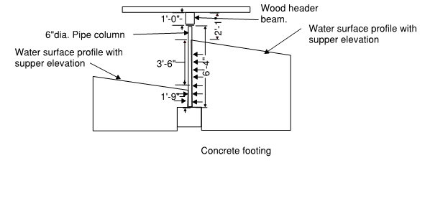
Center Wall Column Failure
Based on inspections the pipe column is not anchored at the top and bottom.
Analysis assumed column was secured by vertical loads and friction.

Slide 7
RECOMMENDED center wall repair

Slide 8
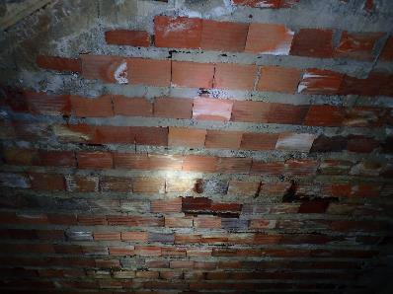
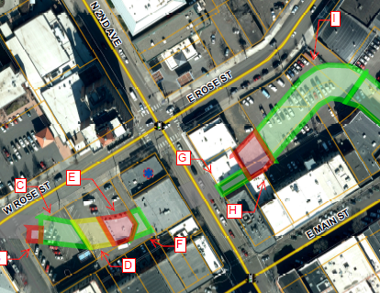
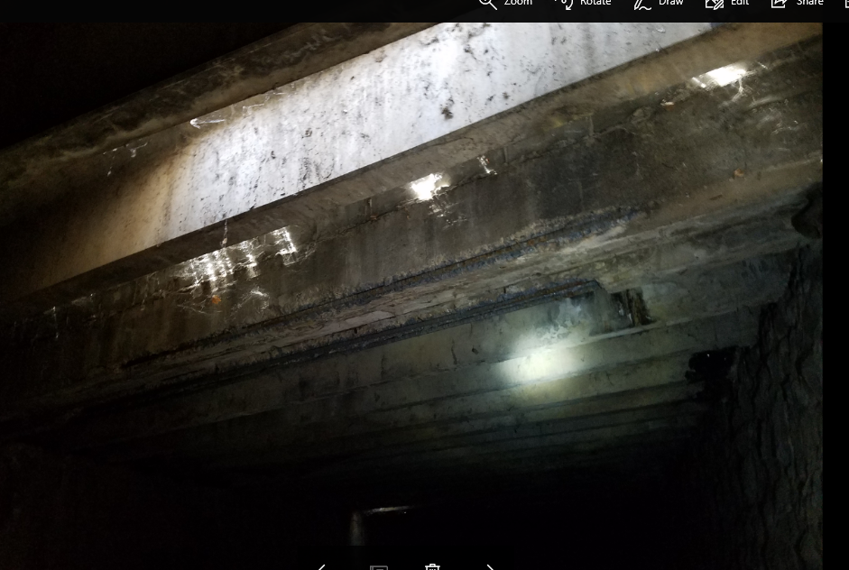
Ceiling removal
Area “A” or Station 135+00
Area “H” or Station 138+00
City of Walla Walla structural report (Sargent, 2016) shows multiple areas that are in poor condition

Slide 9
Ceiling removal

Slide 10
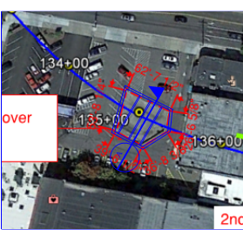
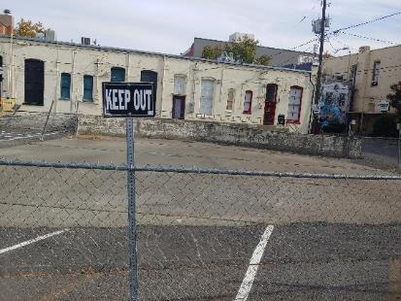
Ceiling removal
STATION 135+00 REPAIR

Slide 11
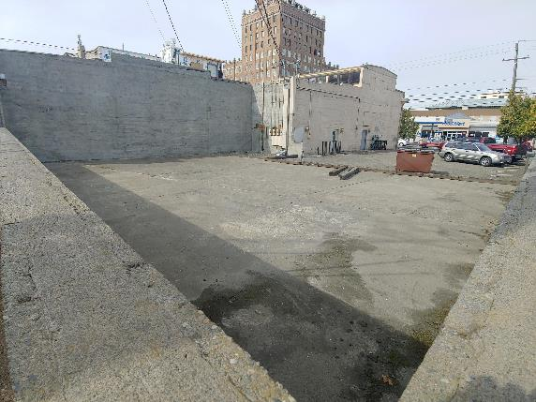
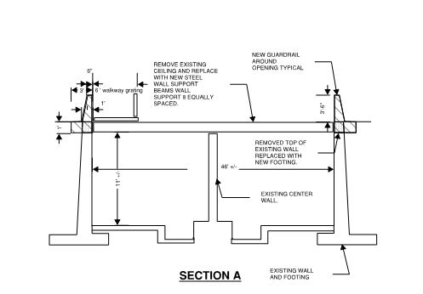
Ceiling removal Station 138+00

